Slide 1


Protecting all your Kubernetes data
Mathew Ericson, Commvault
mericsonAU
mericsonAU
Notes:
G’day everyone my name is Mathew Ericson, I work for Commvault and we are going to take a look at K8s data protection today.

Slide 2
Why data protection?
Stateless
applications undergo migrations (lifecycle, dev/test seeding)
Stateful
applications have persistent data to recover
Unplanned failure occurs everywhere
Notes:
Why are we talking about data protection when containers are stateless? Two reasons: - stateless apps eventually need to migrate cross cluster, data protection is a method to achieve that - stateful apps have persistent data that needs to be recovered.
We are planning ahead for failure - hardware failure, software failure - human error

Slide 3




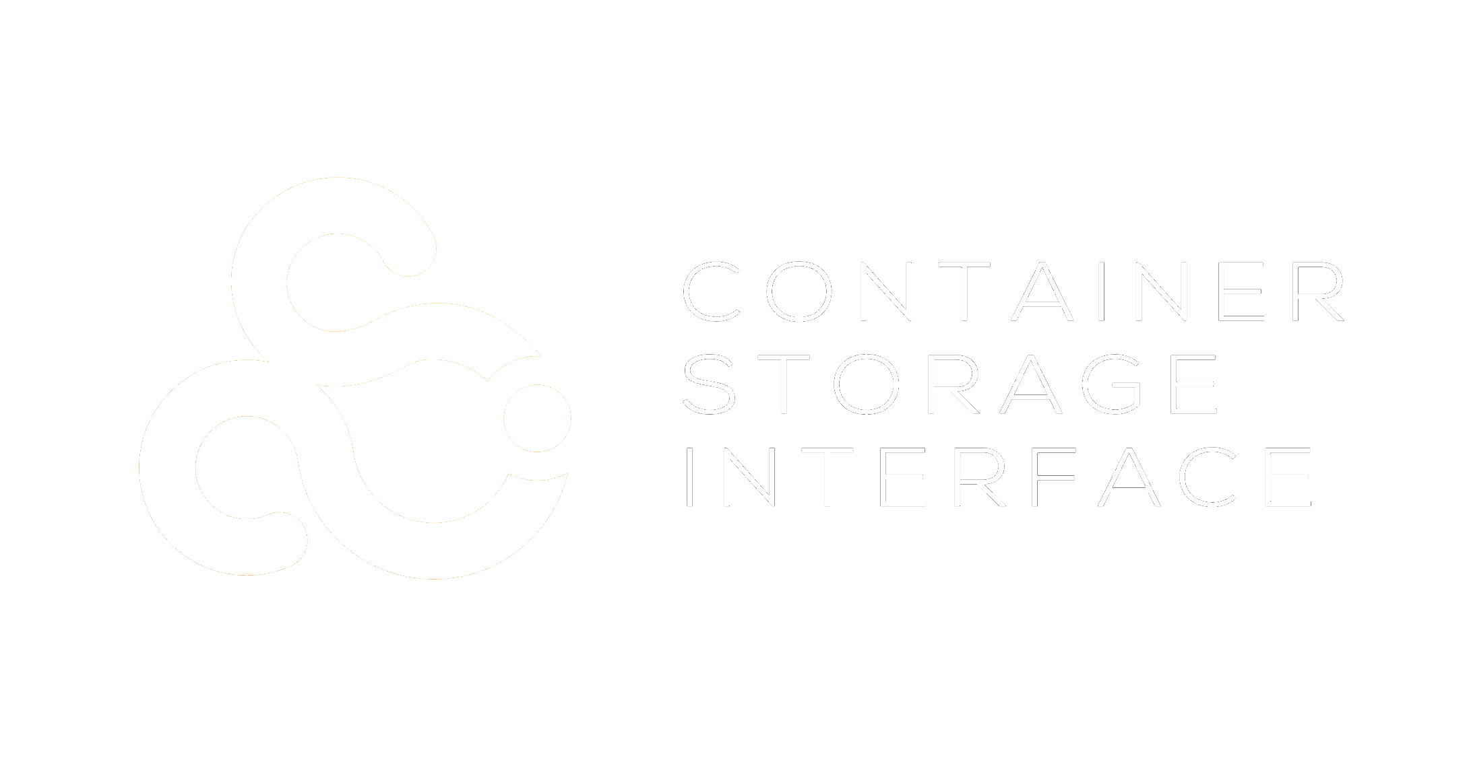



+
K8s data lives everywhere
+
sandbox
manifests
source-code
container
images
K8s
applications
persistent
storage
Notes:
So before we get into the details of how data protection works. It is important to consider the data outside of your K8s cluster.
From developer sandboxes, image registries, and external storage subsystems. You want to ensure you can recover everything associated with your application.
(we are focusing on K8s applications + persistent storage today)

Slide 4
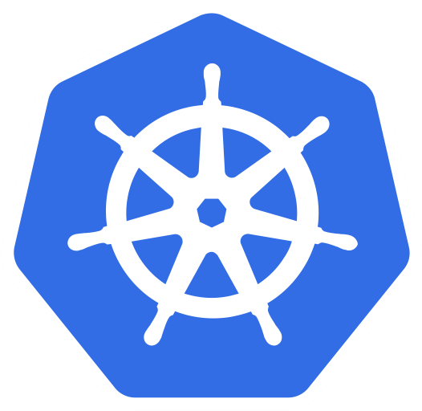
What is an K8s application?
=
POD specification
Deployment
ReplicaSet
StatefulSet
DaemonSet
Services
ConfigMaps
Secrets
Custom Resources
Persistent Volumes
Persistent Volume Claims
Deployment
Statefulset
Replicaset
HELM chart
✓
All of the above
Notes:
What is an application?
Well that is a work-in-progress
It is safe to assume an app is a collection of API resources + optionally, some persistent data.
How do we understand connections between loosely coupled objects – HELM charts, labels, selectors, annotations are all used today.

Slide 5
Data protection types
use-case 1
Data-centric
use-case 2
App-centric
Notes:
So let’s take a look at the two methods for protection today – data-centric, and app-centric

Slide 6




1 - Data-centric backup
Custom Operator uses CronJob resource to schedule vol snap + replicate
Persistent volumes are snapped and replicated
A Custom Operator provides scheduling and retention resources
kube-apiserver
1
Operator
CSI
1
volume
snapshot
snapshot
replica
Notes:
Data centric backups use a custom operator that leverages K8s to schedule the snapshot and replication of persistent volumes.
Schedule and retention may be configured via a custom resource

Slide 7



1 - Data-centric restore
Recovery creates replica volume + application manifests
Recovery creates a volume from replicated snapshot
Developer supplies manifests
Application is rescheduled on cluster
kube-apiserver
1
1
2
CSI
sched
2
YAML
volume
replica
Notes:
Data centric restores then take that replicated snapshot, create a volume and reschedule the app on the cluster (using developer supplied application manifests)

Slide 8

2 - App-centric backup
kube-apiserver
kube-apiserver
(config data)
DataMover POD (PV data)
Entire application is captured
config, metadata
data
Can protect CSI and non-CSI volumes
Pushes backup in vendor neutral format to cloud / off-cluster
Data Mover
1
CSI
2
2
1
volume
snapshot
application
manifests
Notes:
Application centric backup has one important distinction – Step 1 captures all the api-resources (manifests) before capturing the persistent data.

Slide 9
2 - App-centric recover
kube-apiserver
(config data)
DataMover POD (PV data)
Application volumes are recreated (CSI)
Persistent data is recovered
Application is rescheduled with original objects
Recovery to any api compatible cluster
kube-apiserver
1
Data Mover
2
CSI
sched
2
1
volume
snapshot
Notes:
Application centric recovery then simply recreates the PV, populates with data and then reschedules the application with the stored manifests.

Slide 10
Which method is best?
It depends…
development
begins
project
begins
project
release
general
availability
modern
application
Notes:
So which method is best
It depends….

Slide 11
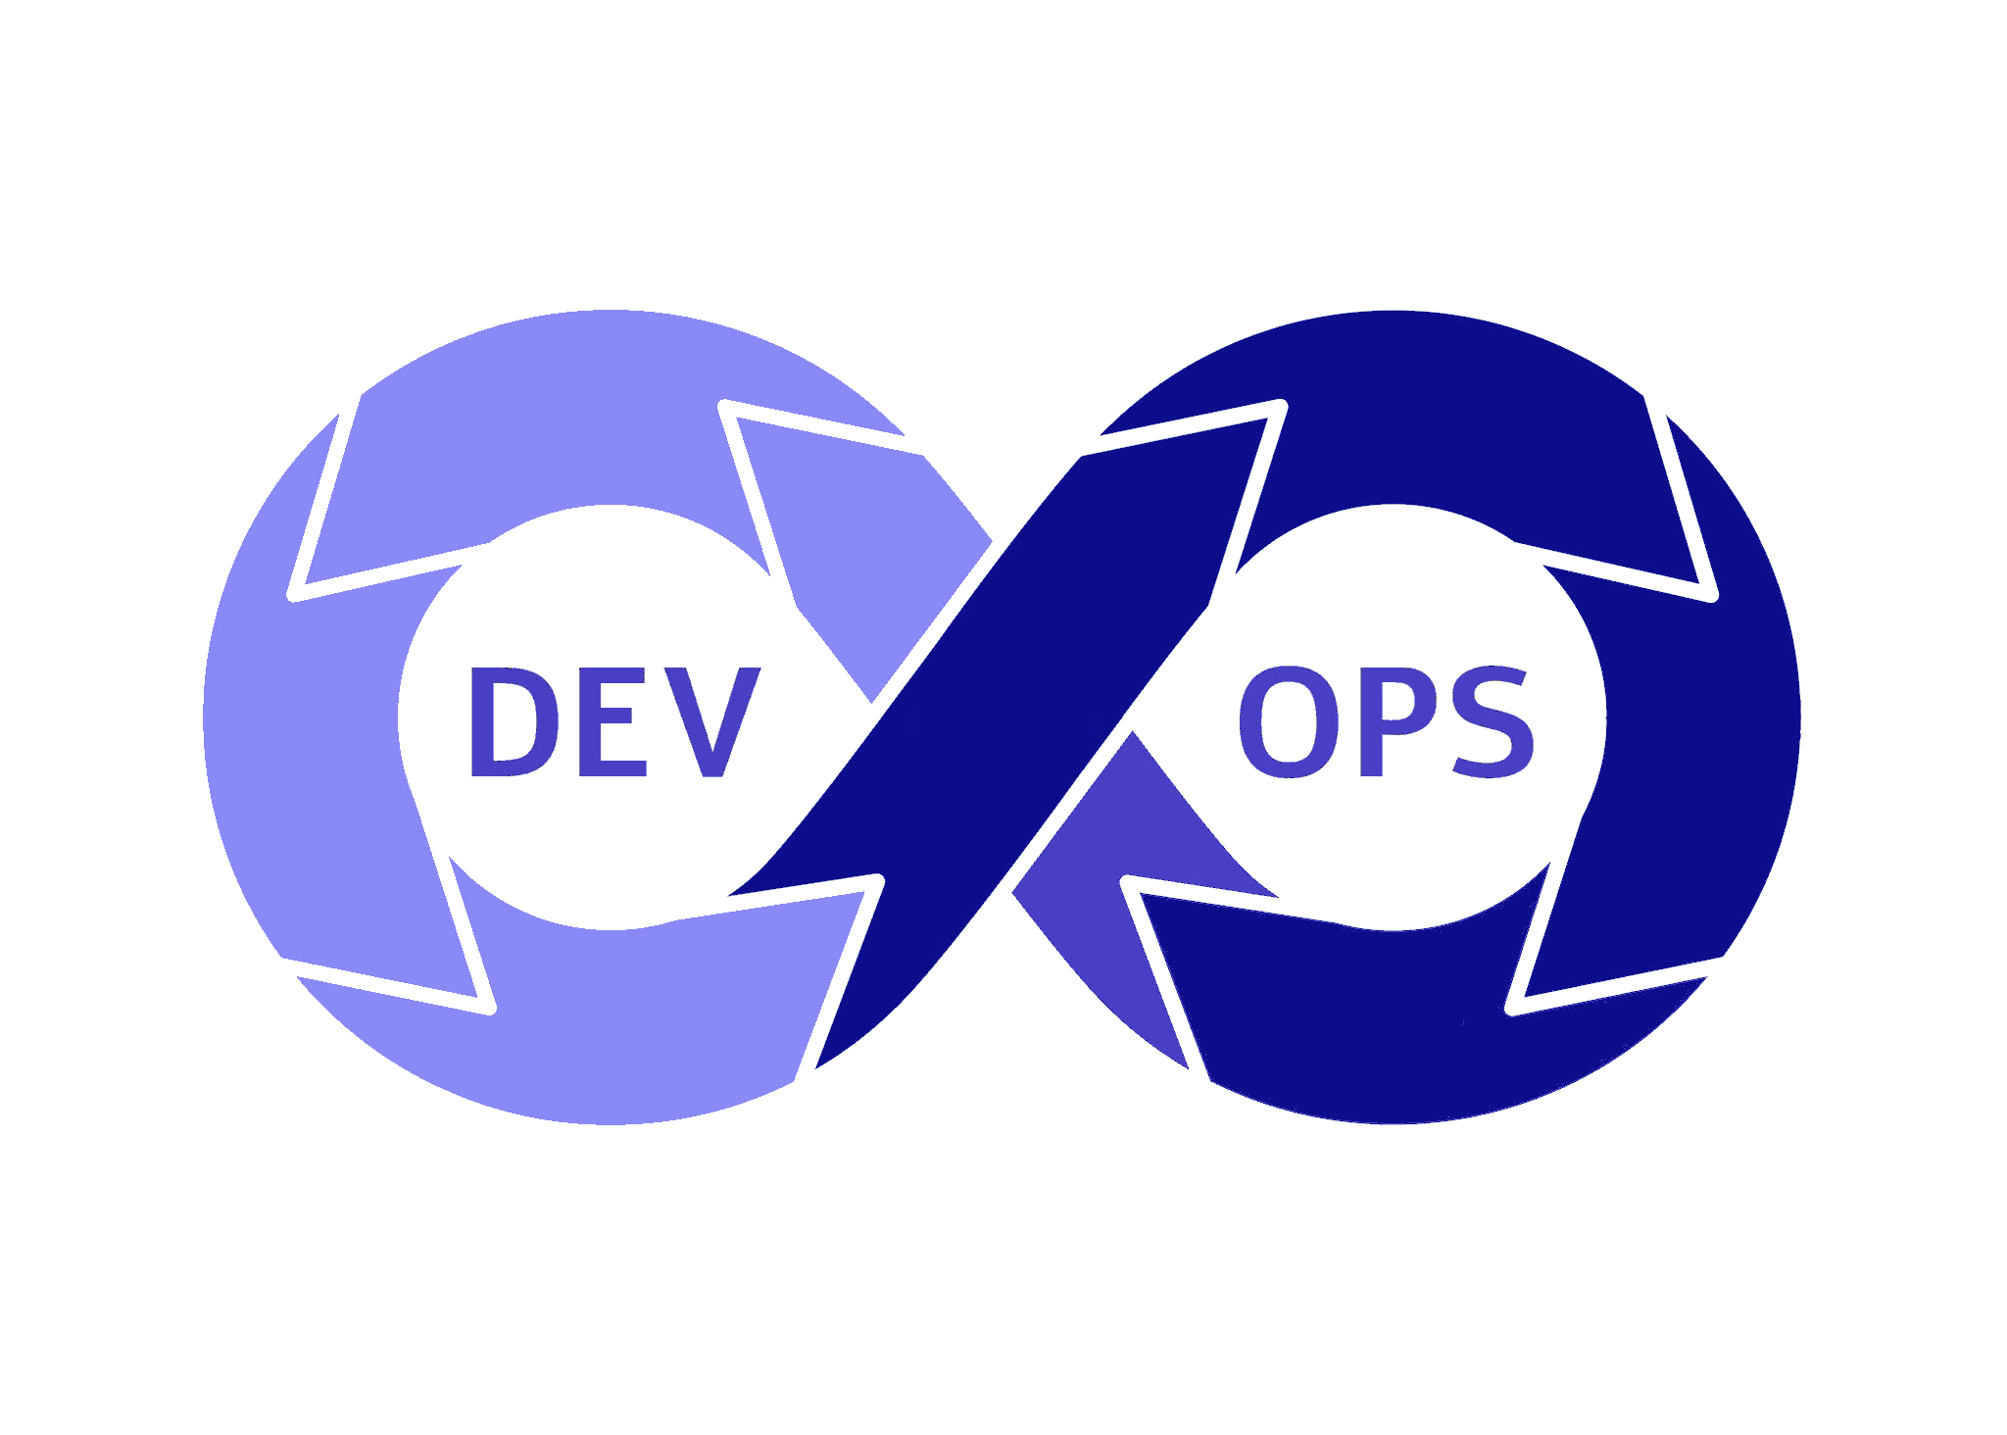
Which method is best?
Data
Application
project
begins
project
release
general
availability
modern
application
Kubectl orchestrated protection
Same-to-Same storage
Enhanced protection scenarios (Change Block Tracking, Replication)
Operations controlled protection
Same-to-Different storage
Notes:
Data centric leverages K8s native configuration and unlocks enhanced protection capabilities like Change Block Tracking (CBT) and Replication (not available via CSI currently)
App centric allows hand-off of protection to a centralized Ops team, and permits lifecycle migrations between cluster/storage types.

Slide 12


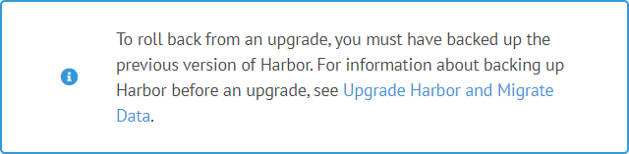
What about your images?
Protecting the Container Image Registry, HELM charts, etc.
Replication is not protection – but it advised for edge performance
What if someone didn’t check-in the manifest correctly
Replication does not protect from corruption
Backup your image registry
Backup your HELM charts
Backup / Recover REST APIs are not yet available
development
begins
project
begins
project
release
modern
application
Notes:
So looking at Harbor, what can you do here?
Harbor can and should have backups (see note from install guide).
In future a backup API would help in identifying new/changed Harbor data for protection.

Slide 13
Where do we go next
Application consistency
OPA policies
Kubevirt protection
Consider
application
recovery
as you
adopt new
tools
CSI
enhancements (CBT, consistency groups)
Application CRD
etcd protection
Hierarchical Namespaces
Harbor
protection
Observability/ Analysis
Notes:
So what else is going on – if we look into our crystal ball? Well CSI is evolving for CBT, consistency groups. Applications are better defined via the Application CRD. And Hierarchical Namespaces are advancing, which we positively impact the multi-tenancy nature of clusters and their protection.
And the workloads to protect are always growing from Harbor, Per-application consistency, to running VMs on K8s.
Key: Consider how you will recover your application as you select new tooling.

Slide 14



Join our community!
# data-protection-wg
mailing list
meeting recordings
Continue the discussion on # 2-kubecon-lightning
Notes:
Thank you for your time today, let’s continue the discussion – get involved in the data-protection wg, or head over to # 2-kubecon-lighting to have a chat… enjoy the rest of the show

